Slide 1
Symptoms of plant diseases

Slide 2
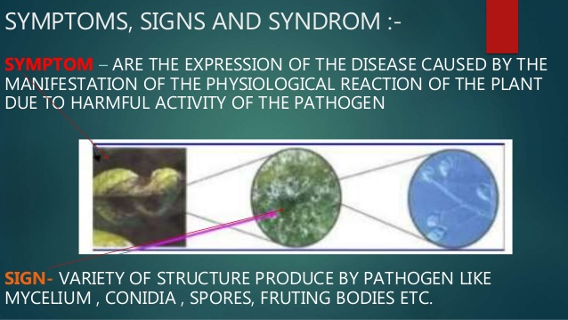

Slide 3
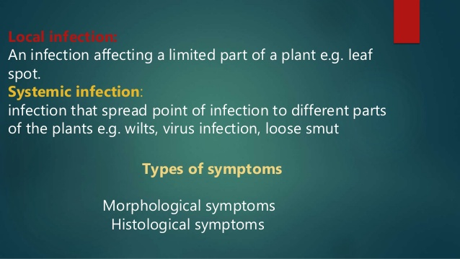

Slide 4
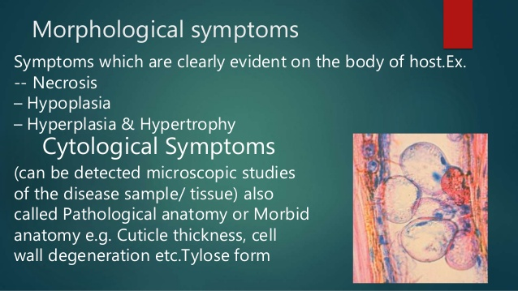

Slide 5
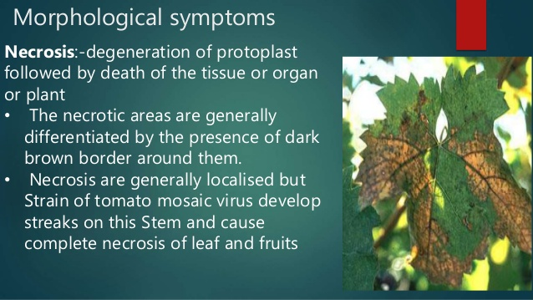

Slide 6
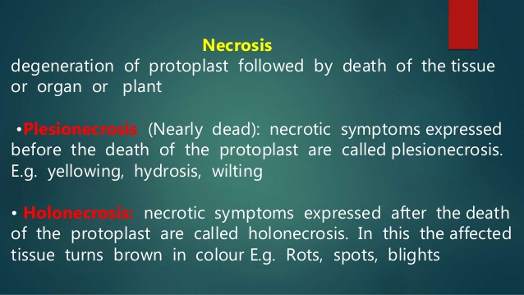

Slide 7
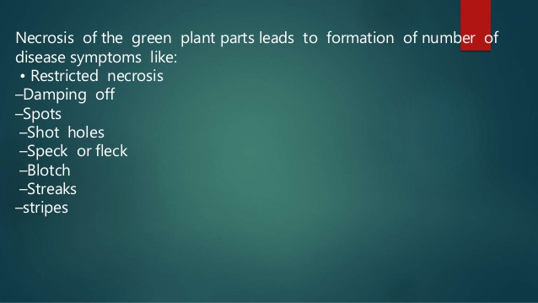

Slide 8
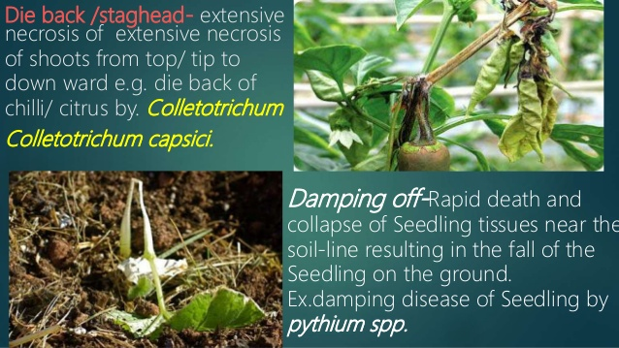

Slide 9
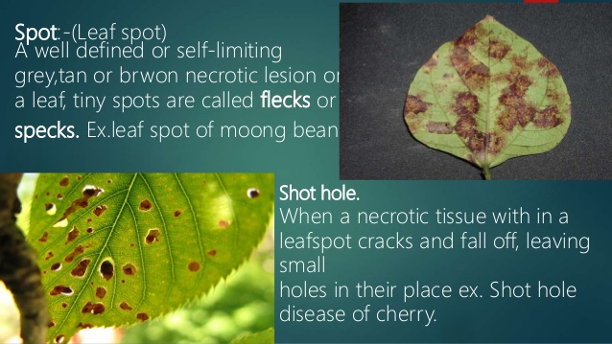

Slide 10
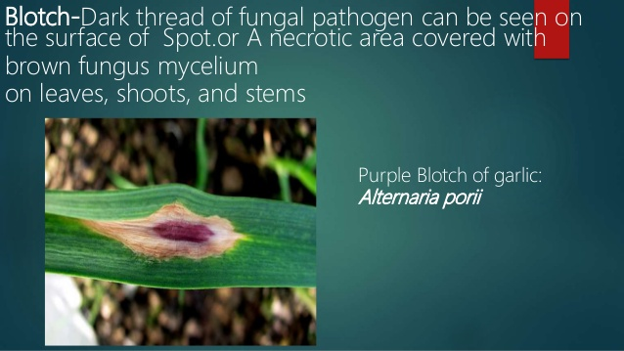

Slide 11
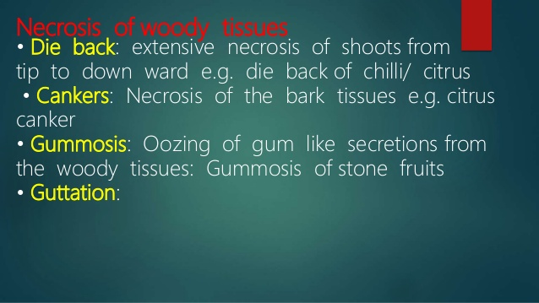

Slide 12
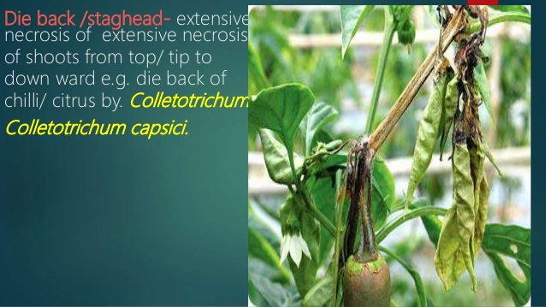

Slide 13
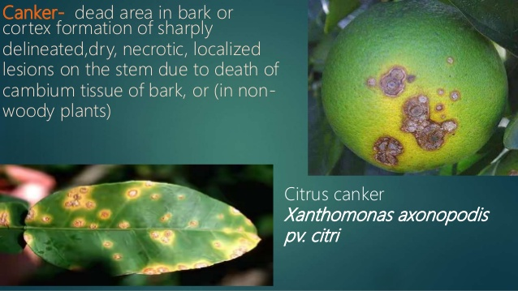

Slide 14
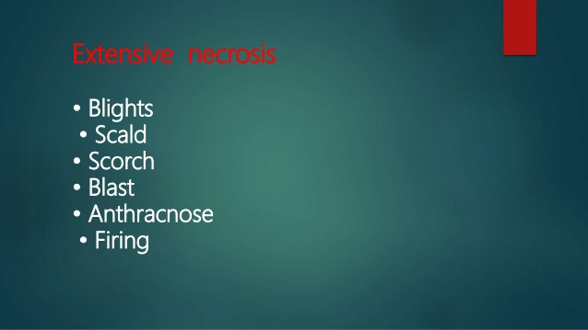

Slide 15
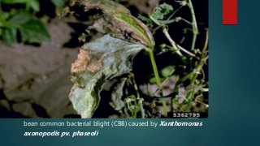

Slide 16
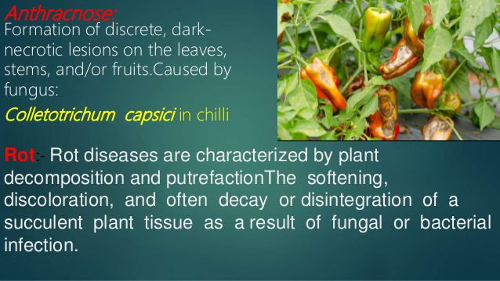

Slide 17
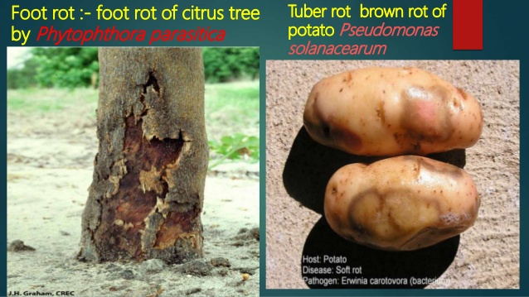

Slide 18
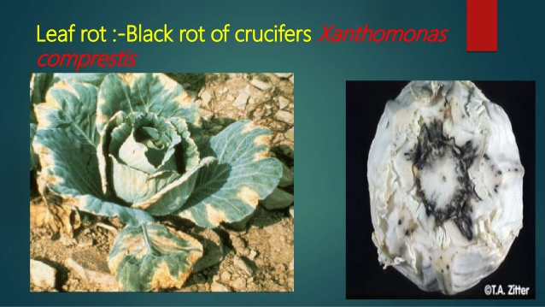

Slide 19
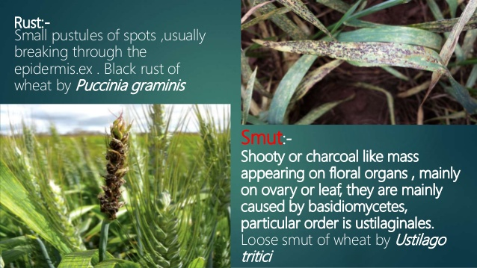

Slide 20
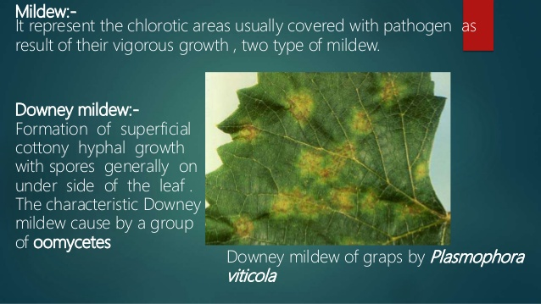

Slide 21
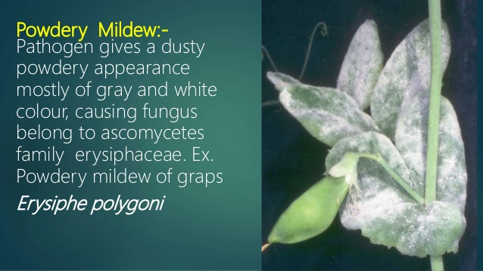

Slide 22
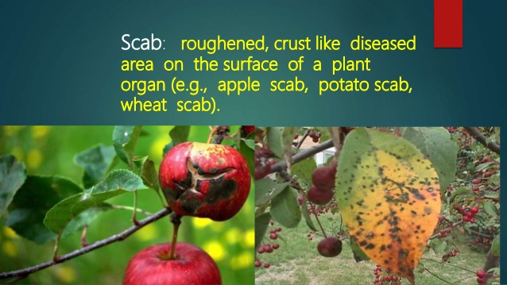

Slide 23
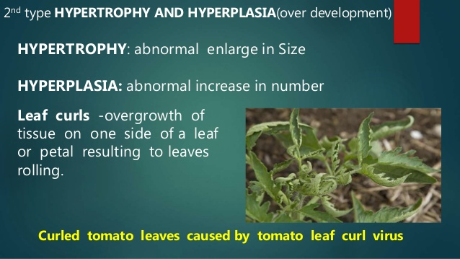

Slide 25
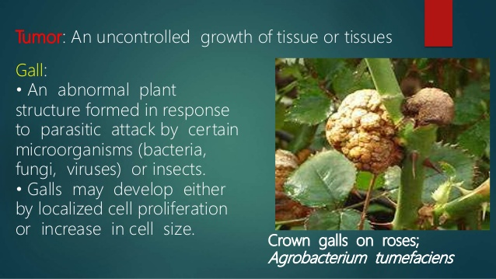

Slide 26
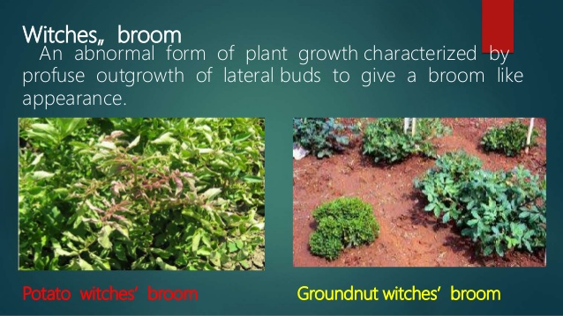

Slide 27
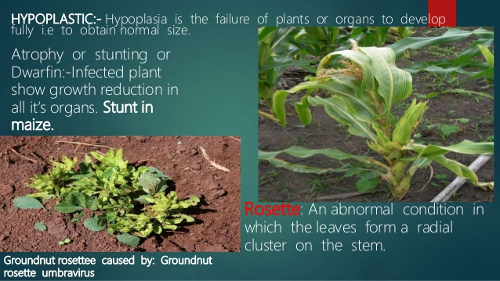

Slide 28
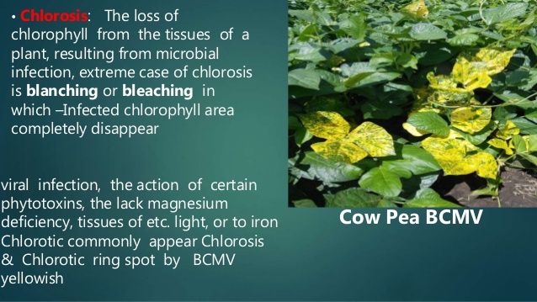

Slide 29
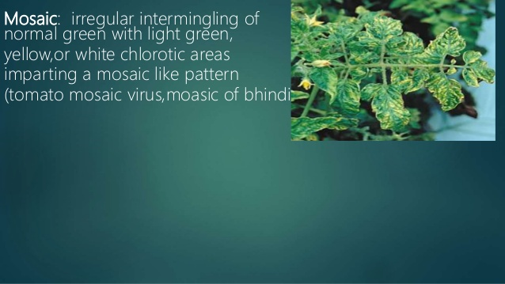

Slide 30
Plant pathogens induce reactions in the body of their host.
As a result certain abnormalities appear on the plant.
In addition the pathogen may itself become visible on the host surface .

Slide 31
The abnormalities , sign or the evidence of the disorder are known as symptoms of the. disease

Slide 32
Mildew:
Pathogen is seen as white, grey ,brownish or purplish growth on the host surface.
In downy mildews the superficial growth is a tangled cottony or downy growth while in powdery mildews enormous numbers of spores are formed on superficial growth of the fungus giving the host surface a dusty or powdery appearance.

Slide 33
Black minute fruiting bodies may also develop in the powdery mass

Slide 34

Rusts:
Diseases with rusty symptoms
They appear as relatively small pustules of spores usually breaking through the host epidermis.
Pustule maybe either dusty or compact .
Red,brown,yellow or black in colour.

Slide 35
Smuts:
Word means a sooty or charcoal like powder.
Affected plants show a black or purplish black dusty mass
It maybe found on stem, leaves as well as roots

Slide 36
White blisters: on leaves of cruciferous and other plants there maybe found numerous white blister like pustules which break open the epidermis and expose powdery masses of spores.

Slide 37
Blotch:
This symptom consists of a superfluous growth giving the fruit a blotched appearance as in the sooty blotch and flyspeck of apple fruits

Slide 38
Sclerotia:
A sclerotium is a compact , often hard mass of dormant fungus mycelium.
In some diseases as in ergot of graminaceous plants the sclerotium assumes a characteristic shape .
In others it maybe variable

Slide 39
Sclerotia are mostly dark coloured

Slide 40
Exudations:
In several bacterial diseases such as in bacterial blight of paddy, bacterial leaf streak of paddy and fire blight of pome fruits masses of bacterial cells ooze out to the surface of the affected organ where they maybe seen as drops or smear.

Slide 41
Often they may form a crust after drying

Slide 42
Symptoms resulting from internal disorders in the host plant may appear in one or more of the following forms:
Colour change: change of colour from the normal or discolouration is one of the most common symptoms of plant diseases.
The green pigment may disappear entirely and its place maybe taken by yellow pigments.

Slide 43
When this yellowing is due to lack of light it is called etiolation.

Slide 44
A similar condition results from the influence of low temperature, lack of iron, excess of lime or alkali in the soil and infection by viruses , fungi and bacteria
In these cases the yellowing is known as chlorosis .

Slide 45
sometimes the leaves are devoid of any pigment and look bleached or white.
This condition is known as albinism
Change of colour to red, purple or orange is chromosis

Slide 46
Overgrowths and hypertrophy:
Many pathogens through their biochemical activity induce excessive growth of host tissues.
This causes abnormal increase in size of affected organs

Slide 47
It is brought about by one or both of the two processes known as hyperplasia and hypertrophy.
Hyperplasia is the abnormal increase in the size of a plant organ due to increase in number of cells of which the organ is composed.

Slide 48
The cell division is increased and so the number of cells at a given location is much higher than normal
In hypertrophy the increased size of the organ is due to increase in the size of cells of a particular tissue.

Slide 49
The pathogen may dissolve intervening walls between adjacent cells or biochemicals RELEASED by it may cause the cell to increase in size.
The overgrowths and their effects are of different types such as galls, curl, pocket or bladder, hairy root , witches broom, intumescence etc

Slide 50
Atrophy:
Or hypoplasia or
Dwarfing:
In many diseases one of the results is inhibition of growth resulting in stunting or dwarfing

Slide 51
The whole plant maybe dwarfed or only certain organs maybe affected
Sometimes hypertrophy and atrophy both are present in the same organ

Slide 52
Necrosis:
Indicates the condition in which death of cells , tissues and organs has occurred as a result of parasitic activity.
Symptoms: spots, streaks, stripes, canker, blight, damping off, burn, scald or scorch and rot

Slide 53
Wilts:
Drying of the entire plant
Loose turgidity
Become flaccid and droop

Slide 54
Die back or wither tip:
Drying of plant organs especially stem or branches

Slide 55
Defence mechanism
Physiological or biochemical defence is more important and common than structural defence as methods for resisting invasion by plant pathogens

Slide 56
By biochemical conditions and reactions the host inactivates the pathogen or its toxins or kills it before the infection spreads and the disease becomes serious

Slide 57
These biochemical mechanisms maybe present in the plant prior to attack.
But more commonly they develop in response to pathogenic activities(post infectional biochemical defence)

Slide 58
The chemical compounds present in the plant or synthesised in response to infection have been classified.
The antifungal components can be classified into four groups: (according to Ingham)

Slide 59
PROHIBITINS
Inhibitins
Post inhibitins
phytoalexins

Slide 60
Proinhibitins and inhibitins are normal constituents of the plant involved in constitutive or semi constitutive defence materials.

Slide 61
Post inhibitins are formed by minor alterations of pre existing compounds.
Phytoalexins are post infectionally produced metabolites.

Slide 62
Bell had called the compounds pre existing in the plant as constitutive antibiotics
Those formed in response to wounds as wound antibiotics

Slide 63
Antifungal and antimicrobial compounds released by the plant in the environment:
during the growth and accompanying activities of higher plants there is a continuous exchange of materials with the surrounding environment.

Slide 64
Plants not only take in water and nutrients from soil and carbondioxide and oxygen from the atmosphere but also liberate gases as well as organic substances from leaves and roots.

Slide 65
These leaf and root exudates contain those biochemicals which are produced during metabolic processes of the plant cells such as amino acids, sugars, glycosides, organic acids, enzymes, alkaloids, nucleotides and flavanones, inorganic acids, and also certain growth factors and toxic materials

Slide 66
They have a profound effect on the nature of the environment including the phyllosphere and the rhizosphere microflora and fauna.
These substances may accumulate in minute drops on leaf surfaces or diffuse in the moisture of the environment around leaves and roots.

Slide 67
A number of inhibitory substances are also included in the exudates.
They directly affect microorganisms or encourage certain groups to dominate the environment and function as antagonists of the pathogen

Slide 68
Tomato leaves- excrete chemicals that provide resistance to attack of Borytis cinerea.
Cowpea leaves resistant to Cercospora leaf spottoxic substances that inhibit germination of conidia.

Slide 69
In leaf spot of sugarbeet ( Cercospora beticola) low incidence of local lesions on the leaves of a resistant variety has been corelated with the presence of a diffusible inhibitor from healthy leaves

Slide 70
Spore germination of the fungus inhibited by resistant leaves, their water washings and dew deposited on such leaves.

Slide 71
Certain powdery mildew resistant varieties of apple exude toxic waxes on leaf surfaces which prevent germination of conidia of Podosphaera leucotricha
Apple varieties producing low amounts of this wax are usually susceptible to powdery mildews.

Slide 72
Epidermal excretions play an important role in establishing infection of plasmopara viticola.
Red scales of onion contain protocatechuic acid and catechol which may exude in drops and impart resistance to attack of colletotrichum circinans

Slide 73
These phenolic substances inhibit spore germination of the fungus
Wrinkled seeded varieties of pea are susceptible to seed and root rot because the seeds exude very high quantities of sugars which encourage the growth of pythium

Slide 74
Indirectly the exudates may suppress the growth of pathogens by encouraging other microorganisms to grow and compete with the pathogen or produce antibiotics

Slide 75
Root exudates sometimes contain substances that are directly toxic to a pathogen
Certain varieties of linseed resist wilt caused by F oxysporum f. sp. Lini through the presence of hydrocyanides in their root exudates.
Extremely toxic to the wilt pathogen
Reduces its infectivity around the roots

Slide 76
It is present in the roots also and imparts resistance.
Does not affect the development of trichoderma spp

Slide 77
Marigold –used in biological control of nematodes
Presence of polyenes, terthienyl and derivatives of biethienyl in the root and root exudates

Slide 78
Asparagus officinalis-toxic material against nematode trichodorus christiei
Cucurbits(bitter cucumber)- cucurbitacin=nematode

Slide 79
Inhibitors or antimicrobials present in the plant cell
Plants produce thousands of naturally synthesised compounds many of which are unique to specific taxonomic groups and are toxic to animals including insects and to microorganisms

Slide 80
These compounds maybe completely sybthesised and stored in vacuoles, lysigenous glands, ducts, heartwood and periderm.
Less toxic precursors maybe stored in vacuoles with the final antibiotic being formed by the action of hydrolases and oxidases located in other parts of the cells

Slide 81
Antimicrobial substances preexisting in the plant cells include unsaturated lactones, cyanigenic glycosides , sulphur containing compounds, phenols and phenolic glycosides and saponins

Slide 82
Mechanical or pathogenic injury to the tissue brings these glycosides in contact with separately stored enzymes
Action of hydrolysing enzymes on cyanogenic glycosides instantly release HCN extremely toxic

Slide 83
IN many diseases these pre existing toxic substances in the cells form the basis of immunity or resistance.

Slide 84
When tissues are crushed or damaged the glycoside is acted upon by the enzyme myrosinase.
This produces isothiocyanate
In some plants action of isomerase converts this compound to thiocyanate.
Antibacterial, antifungal,antinemic –mustard oil

Slide 85
Allyl sulphonide-onions, garlic
Glucosinolates-cabbage
Cyanogenic glucosides-sorghum,lima bean, peach
Para hydroquinone glucosides- pear and walnut
Benzoxazines-maize, wheat,rye

Slide 86
Aq extracts of plant parts –germicidal garlic seed –loose smut infected wheat
Onion, garlic bulb extracts, ginger , leaves of parthenium,calatropis, margosa- macrophomina, erysiphe
Rhizomes of ginger-pea powdery mildew
Extract of margosgreen mold p digitatum

Slide 87
Aq extracts of some plants have antiviral properties
Phenolic compounds like simple phenols,coumarines,flavonoids. Complex phenols such as tannins
Many present in intact tissues
Are released upon enzymatic fission by beta glycosidases

Slide 88
Eg catechol – onion smudge
Pyrocatechol- roots of eragrastis curvula-root knot nematodes
Scab of potato-resistant varieties contain chlorogenic acid
Phenol has toxicity to the bacterium
Resistance to root knot nematodes in tomato has also been ascribed to chlorogenic acid

Slide 89
Some varieties of potato has this acid-resistant to verticillium wilt (V albo-atrum)
Saponins are glycosides
Widely present in plants
Important for disease resistance
These antimicrobial compounds include avenacins, a triterpene present in roots of oats, solanin ,tomatin,chaconin

Slide 90
They adversely affect only those cells that contain sterols in their membrane system
Saponins react with cell membrane sterols to form insoluble complexes
In this process pores develop in the cell membrane through which there is leakage of electrolytes and nutrients
U;timately the cell dies

Slide 91
Change in the cell wall permeability is irreversible
Saponins such as tomatin and solanin are highly antifungal
Their toxicity is more against nonpathogens

Slide 92
Roots of oats-saponins avenacin A and B
Fungal invasion of oat roots triggers release of avanacins from protoplasts simultaneously with leakage of electrolytes and nutrients
A virulent fungus such as Fusarium avenaceum can detoxify low concentrations of avanacin A through enzymic action converting it to relatively less toxic avenacin B

Slide 93
Skin and healed wound surfaces of potato tubers contain high conc of the fungitoxic alkaloid solanin
Greenings of tubers exposed to sunlight and their bitter taste is skin deep
a;lkaloid prevents infection of healthy tissues by most fungi

Slide 94
Alkaloid prevents infection of healthy tissues by most fungi
Infection of fresh wounds on tubers often suppresses normal alkaloid synthesis diverting it to synthesis of terpenoid phytoalexins
Concentration of alkaloid tomatin is greater in extracts of fusarium resistant tomato than in susceptible tomato cultivars
Alkaloid is toxic to cladosporium fulvum also

Slide 95
Lack of essential nutrients and growth factors for the pathogens
Apple scab disease-pathogen Venturia inaequalis –genetically controlled required for a growth factor in order to become pathogenic
Certain mutants of the pathogen cease to be pathogenic in absence of their ability to synthesise this factor

Slide 96
They can be induced to establish infection by spraying the growth factor on the leaves
In seedling disease of radish and lettuce caused by Rhozoctonia solani successful infection depends on formation of infection cushions from which the infection peg develop and cause penetration of epidermis

Slide 97
Formation of these cushions in induced by certain essential nutrients in the host.indole acetic acid and its precursor tryptophan are necessary for the reproduction of some nematodes

Slide 98
Lack of recognition between host and pathogens
Cell to cell communication
Specific recognition factors
Oligosaccharides
Polysaccharides
Proteins or glycoproteins

Slide 99
Lack of sensitive sites for pathogen toxins
Host specific toxins
Attach to specific sensitive sites or receptors

Slide 100
Absence of common antigens
Antibody like substances

Slide 101
Post infectional biochemical defense
interactions of the host and the pathogen
are a result of of long time continued struggle for existence.

Slide 102
Substance is associated with the protection against the disease at the site where protection occurs.
Substance can be isolated from the host showing protection against the disease

Slide 103
Introduction of the isolated substance to the appropriate substance to the appropriate susceptible host confers protection.
Nature of the protection so induced resembles that of the natural agents of a resistant plant

Slide 104
Toxic materials produced in the plant in response to infection
the defensive strategy of plants exists in two stages.
the first is assumed to involve the rapid accumulation of phenols at the infection site which functions to slow or even halt the growth of the pathogens and to allow for the activation of secondary strategies that would restrict the pathogen

Slide 105
The second is the activation of specific defences such as the synthesis of phytoalexins or other stress related substances.
The sequence of events in a defence response can be thought to include:

Slide 106
The host cell death and necrosis
Accumulation of toxic phenols
Modification of cell walls b phenolic substituents or physical barriers such as appositions or papilae
Synthesis of specific antibiotics such as phytoalexins

Slide 107
Synthesis of inhibitory substances in response to injury caused by a pathogen or any mechanical or chemical agent is one of the most common post infection reaction of the host.

Slide 108
In the injured tissues or series of reactions start to isolate the irritant and heal the wound.
The reactions are determined by the nature of the tissues

Slide 109
Mostly these reactions or responses of the plant form fungicidal or fungistatic compounds around the site of infection or in the cells such as lignin, accumulation of cell wall appositions or papillae and the early accumulation of phenols within the host cell walls

Slide 110
Depending on the intensity and duration of reactions the quantity of these compounds maybe enough to inhibit or kill most microorganisms.
The enzymes required for synthesis of these compounds are present in the host or maybe in response to infection

Slide 111
Phenolic compounds and their role in defence:
the main substances that are formed in plant in response to infection or injury are phenolic compounds such as chlorogenic acid, caffeic acid and oxidation products of floretin,hydroquinone and hydroxytyromine and phytoalexins

Slide 112
Low molecular weight phenols such as the benzoic acids and the phenylpropanoids are formed in the initial response to infection.
Some occur constitutively and are thought to function as preformed inhibitors associated with nonhost resistance.
Others are formed in response to the entry of a pathogen or other injuries

Slide 113
Synthesis of phenolic compounds takes place through shikimic acid and acetic acid pathway.
Reaction of phosphoenol pyruvate formed in glycolysis with erythrose phosphate formed in pentose pathway results in formation of dehydroquinic acid

Slide 114
The pentose pathway is stimulated in a diseased plant
The dehydroquinic acid forms shikimic acid through several intermediate steps.
Shikimic acid forms prephenic acid which is converted intophenylalanine or tyrosine.

Slide 115
These two serve as precursors for synthesis of a wide variety of phenolic compounds such as cinnamic acid, coumarin, caffeic acid, chlorogenic, ferulic acid, phloretin, umbelliferon,scopoletin,isocoumarin and various other phytoalexins.
In acetic acid pathway the phenolics are produced by condensation of acetates formed during breakdown of sugars in respiratory process.

Slide 116
The enzymes for these two pathways are preexisting in the plant.
These enzymes found in healthy and diseased plants are called phenol oxidising enzymes such as phenolases , phenol oxidases and polyphenol oxidases

Slide 117
The two most important phenol oxidases are:
Laccase
Tyrosinase
In presence of oxygen these enzymes oxidise different phenolic compounds either by adding oxygen or by displacing hydrogen

Slide 118
Addition of oxygen to monophenols results in formation of complex polyphenols such as tannins, lignins. Etc.
Displacement of hydrogen forms quinones which are usually coloured and give the specific brown colour to diseased tissues

Slide 119
The enzyme peroxidase is also present in plants and helps in removal of hydrogen atoms from phenolic compounds and adding them to oxygen atoms of peroxide
The phenolic compounds preexisting in the plant whose synthesis is accelerated by infection process are called common phenolics as against those which do not exist in the plant but are formed as a result of interactions between the host and the pathogen

Slide 120
The latter are called phytoalexins
The common phenol compounds are more prevalent and are usually present in the plant before infection.

Slide 121
Their synthesis and accumulation rapidly increases after infection
This increase in synthesis is more rapid in resistant than in susceptible plants

Slide 122
Chlorogenic acid –found in many plants infected with various pathogens such as sweet potato, carrot and potato attacked by Ceratocystis fimbriata and tomatoes attacked by root knot nematode(meloidogyne incognita)

Slide 123
Potatoes affected by late blight fungus shows presence of orthodiphenol and scopoletin
Caffeic acid and umbelliferon are found in sweet potato infected with Ceratocystis fimbriata

Slide 124
Physiological activities –plants infected by phenols indirectly too
Phenols-suppress activity of IAA OXIDISING ENZYMES thus increasing th amount of this auxin or they may stimulate the activity of these enzymes.

Slide 125
Certain fungi hydrolyze non toxic glycosides through the enzyme beta glycosidase produced by them or by the host cells in response to infection.
Hydrolysis of phenolic glycosides yields anti infection phenols

Slide 126
b) Phytoalexins :
There are large number of antibiotic phenolics and other compounds which do not exist in the plant or the pathogen but are formed as a result of host parasitic interaction or any chemical or mechanical injury

Slide 127
Such substances have been termed phytoalexins
It is believed to inhibit further development of most attacking fungi.
Detected in healthy tissues too

Slide 128
Kuc – phytoalexins as antibiotics produced in plant pathogen inter action or as a response to injury or other physiological stimuli.
Phytoalexins- low mol wt. antimicrobial compounds
Pterocarpan phytoalexin pisatin-endocarp tissues of detached pea pods inoculated with monilinia fructicola

Slide 129
Phaseollin- spore suspensions of sclerotinia fructigena or phytophthora infestans when they were incubated in pod cavities of french beans.
Investigations of beans have revealed the existence of three additional chemically related phytoalexins, viz phaseollidin, phaseollinisoflavan, kievitone

Slide 130
Medicarpin – leaves of alfalfa
Triflorirhizin-clover
Maackinin-clover
Also by cicer arietinum
Wyerone and wyeronic acid-broadbean seedlings inoculated with botrytis fabae

Slide 131
Alfalfa- sativin
Incompatible combination of soyabean with phytophthora megasperma yields glyceollin
Compatible combinations yields little

Slide 132
Terpenoid phytoalexins of solanaceae – rishitin,phytuberin,capsidol and glutinasone

Slide 133
2) defence through induced synthesis of proteins and enzymes:
Phenol oxidizing substances present in plants induce resistance by becoming more active in response to infection.
In addition to these biosynthetic compounbds synthesis of proteins and enzymes in large quantities and in modified forms also contributes to post infection resistance of plants

Slide 134
Black root rot of sweet potato
One of the factors inducing these alternations in enzyme system is production of ethylene which itself is not antifungal
It is produced inr response to infection and moves out to adjoining healthy cells where it alters protein synthesis and enzyme activities

Slide 135
Extracts of meloidogyne on tobacco show peroxidase activity but only in contact with plant cells suggesting that peroxidase activity is a plant defence mechanism against nematode invasion.

Slide 136
Phenylalanine ammonia lyase shows invreased activity and greater synthesis in diseased tissues
Degree of resistance depends on the speed and limit of the protein synthesis and the speed with which the synthesised products move out to neighbouring lealthy tissues to form protective layers

Slide 137
3) Formation of substrates resistant to enzymes of the pathogens:
The tissue disintegration by many pathogens is brought about degradation of pectic substances in the middle lamella and disorganization of the tissue framework.

Slide 138
The pectic substances are broken down by the action of parasite produced pectinolytic enzymes such as pectin methyl esterase, pectin glycosidase,polygalacturones and polymethyl galacturonase

Slide 139
Post infection resistance in such cases may develop by formation of substances in the middle lamella which are not affected by these enzymes, for example polyvalent cations of pectin-protein.

Slide 140
Due to response of the cells to infection such substances are formed in the middle lamella and further tissue disintegration is halted
Rhizoctonia solani causes necrosis in bean plants
In resistant varieties the entry of the pathogen and activity of its pectin methyl esterase separates the methyl group from methylated pectic substances and forms polyvanent cations of pectin salts in the vicinity of the pathogen

Slide 141
These polyvalent cations contain calcium
Due to Accumulation of calcium ions the pathogen fails to disintegrate the middle lamella
Growth regulators also aid in the process
Auxins produced by the host of the pathogen demethylate the pectic substances

Slide 142
In presence of appropriate amount of calcium , pectic salts of calcium are formed
These salts are not affected by hydrolysing enzymes
Late blight of potato has been controlled by application of auxins

Slide 143
4) defence through inactivation of pathogen enzymes:
Most necrotophic and hemibiotrophic fungi and most bacteria secrete an array of hydrolytic enzymes that often diffuse into the host tissues in advance of the pathogen securing a nutritional base for the pathogen by breaking down complex molecules into simpler ones

Slide 144
If these hydrolases are inhibited or inactivated pathogenesis can be checked.
In resistant reations of a host this occurs throuh enhanced activity of phenols, tannins and proteins as enzyme inhibitor.
Several phenolic compounds can inactivate the enzymes produced by fungi

Slide 145
Tannins have been demonstrated as inhibitors of pathogen enzymes of botrytis cinerea in the skin of grape berries

Slide 146
5) Defence through detoxification of pathogen toxins:
In many cases there is a correlation between host sensitivity to toxin and susceptibility , toxin production and pathogenicity and between host response to toxins and to attack of the pathogen

Slide 147
Thus it can be assumed that resistance to a toxin induced disease is resistance to the toxin itself.
Resistance to toxins has often been attributed to the ability of the plant metabolic processes to destroy or detoxify these substances

Slide 148
6) Defence through altered biosynthetic pathways:
Respiration in diseased plants or their organs is increased with activation of dehydrogenase, peroxidase, phenol oxidase and deaminase

Slide 149
New enzymes , proteins and other compounds are also synthesised
Accumulutaion of these substances maybe in quantities sufficient to harm the pathogen
Most of these compounds are formed through shikimic acid pathway and modified acetate pathwy

Slide 150
In diseased plants a part of the glycolysis is replaced by pentose pathway which forms the 4 carbon compound erythrose phosphate essential for initiation of shikimic acid pathway

Slide 151
Although pentose pathway predominates in diseased plants glycolysis also continues and forms the 3 carbon compound phosphoenol pyruvic acid that combines with erythrose phosphate to initiate shikimic acid pathway leading to synthesis of common phenols and phytoalexins

Slide 152
7) Defence triggered by previous invaders:
Cross protection has been reported mainly in virus diseases.
This type of protection is based on induction of structural or biochemical defence mechanisms by invasion of the host by an avirulent strain of the pathogen or a weak pathogen

Slide 153
The principles of cross protection overlap with other principles of defence mechanism .
The mechanisms of retardation of the main pathogen arriving after the previous invader maybe attributed to
Induction of phytoalexins
Production of antibiotics
Competition for nutrients

Slide 154
When a crop is inoculated with a mixture of spores from virulent and avirulent isolates of the same pathogenic fungus enlargement of lesions is slower with the mixed inoculation than with the virulent isolate alone

Slide 155
8) Hypersensitivity as defence mechanisms:
Rapid death of host cells
Tissue browning
Accumulation of antimicrobial components
Characteristic of resistant than susceptible cells

Slide 156
It provides both structural as well as physiological defence
In many plant diseases when the pathogen comes in contact with host cell wall or cytoplasm the nucleus moves towards the pathogen

Slide 157
Soon it gets disorganized
Brown granules are formed in the cytoplasm
Granules accumulate around pathogen
Then disperses in the entire cell
Cell wall swells
Host cell is killed

Slide 158
Necrotic or abortive defence reaction causes the organs of the pathogen to degenerate,
Its nuclei disorganised
Cytoplasm becomes dense
Pathogen is unable to move out of the necrotic cells

Slide 159
Responses seen when there is no compatibility between host and invading pathogen
Latter fails to establish parasitic relationship

Slide 160
Incompatibility can be explained as ability of the host to recognise the pathogen and failure of the host to duppress the subsequent biochemical changes leading to rapid death of the host cells

Slide 161
It could be due to:
Invading pathogen contains the components necessary for its recognition by the host cell
Resistant host cells have the ability to recognise these components of the invading pathogen

Slide 162
iii) The invading pathogen may lack factors which inhibit the host recognition system
iv) Even if recognition of the invading pathogen takes place, the pathogen maynot be capable of inhibiting few or more of the subsequent steps leading to resistant reaction
v) Even if all processes of the host resistant reactions are activated the invading pathogen maynot be tolerant of them

Slide 163
1902-H M Ward
1915- E C Stakman

Slide 164
summary

